Slide 1

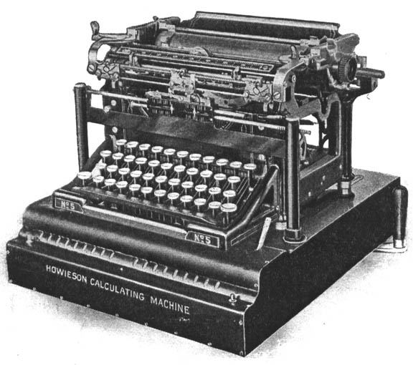
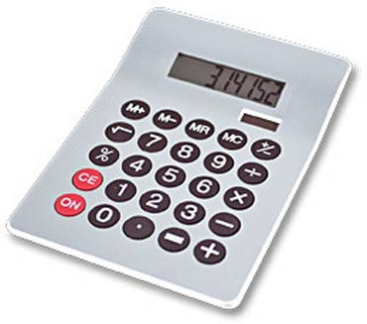

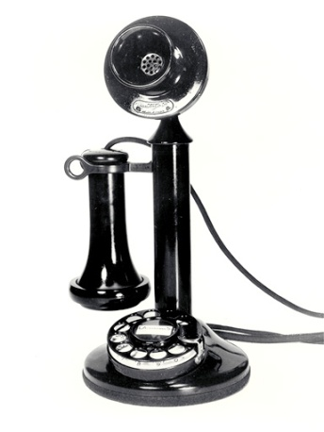
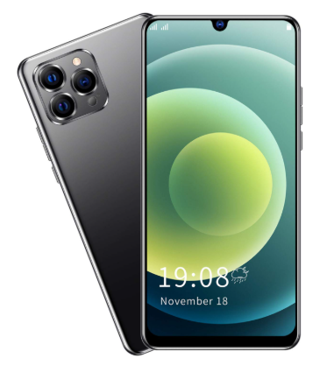
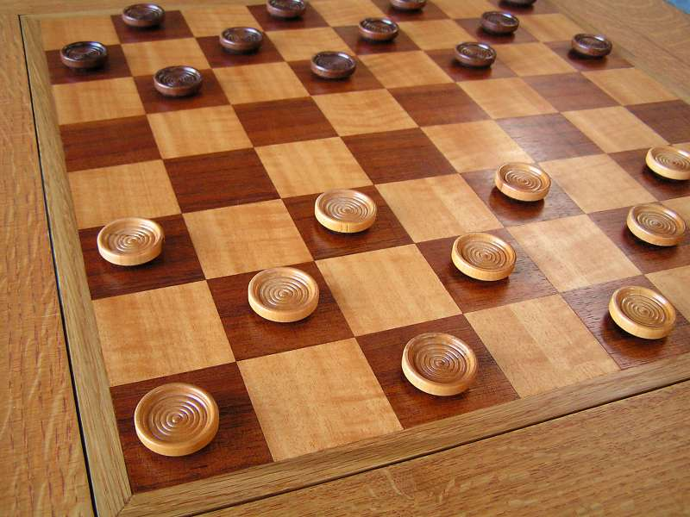
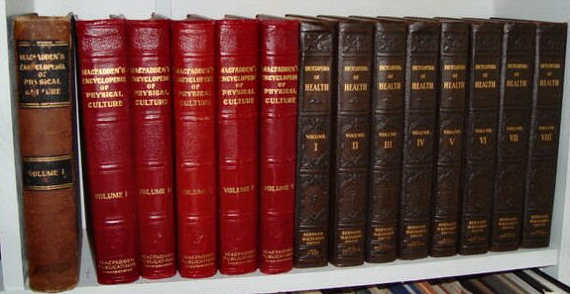
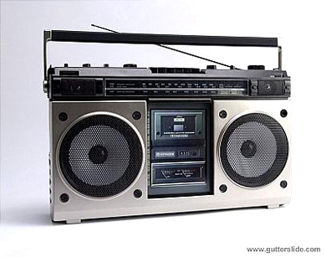
Programmable Machines

Slide 2
Programmable Machines
Computers are programmable
Unlike other machines, it’s cheap and easy to tell a computer how to solve a new problem
Even a problem that no one had thought of when they made the computer!
This is what makes computing such a powerful tool

Slide 3
Programmable Machines
Computers are programmable
Unlike other machines, it’s cheap and easy to tell a computer how to solve a new problem
Even a problem that no one had thought of when they made the computer!
This is what makes computing such a powerful tool
Computer Science is the science and practice of solving problems using computing
The Science:
What is computing? How does it work? What can and can’t it do?
The Practice:
How to you solve real-world problems with computing?

Slide 4
What Problems?
What kind of problems do you want to solve?
Can computing help with that?

Slide 5
What Problems?
What kind of problems do you want to solve?
Can computing help with that?
Computing is processing data
Data (numbers, text, images, videos)
Input (user interaction, data sources, sensors)
Output (screens, audio, electronics including other computers)
Examples: alarm, text messages, drone flight

Slide 6
What Problems?
Imagine you have a touchscreen that you can put on any object in your house, turning it into a computer
It can have sensors, connect to the internet, control other devices
Example: digital thermostat
What kinds of problems could you solve?
What data is involved and how does the computer use it?

Slide 7
What Problems?
Imagine you have Augmented Reality (AR) glasses that can display objects as if they were in the real world
You can connect to wearable sensors, the internet, control other devices
Example: friend locator
What kinds of problems could you solve?
What data is involved and how does the computer use it?

Slide 8
What Problems?
Over 90% of Americans carry a smartphone
Everybody has a computer with them!
We have smart homes, cars, offices, schools, hospitals…
What kinds of problems do you want to solve?

Slide 9
Artificial Intelligence
The big topic right now
What is “Generative AI”? How does it work?
What problems can it solve?
What are its limitations? Costs? Dangers?
As a student, how should you approach AI?
What should your instructors be doing with it?
What policies should the University have?

Slide 10
Artificial Intelligence
The big topic right now
What is “Generative AI”? How does it work?
What problems can it solve?
What are its limitations? Costs? Dangers?
As a student, how should you approach AI?
What should your instructors be doing with it?
What policies should the University have?
A Computer Scientist is an expert on computing
You have to always be learning
Staying ahead of it is a big challenge

